Slide 1

Oracle 11g: SQL
Chapter 11
Group Functions

Slide 2
Objectives
Differentiate between single-row and multiple-row (group) functions
Use the SUM and AVG functions for numeric calculations
Use the COUNT function to return the number of records containing non-NULL values
Use COUNT(*) to include records containing NULL values
Use the MIN and MAX functions with nonnumeric fields
Oracle 11g: SQL

Slide 3
Objectives (continued)
Determine when to use the GROUP BY clause to group data
Identify when the HAVING clause should be used
List the order of precedence for evaluating WHERE, GROUP BY, and HAVING clauses
State the maximum depth for nesting group functions
Nest a group function inside of a single-row function
Oracle 11g: SQL

Slide 4
Objectives (continued)
Calculate the standard deviation and variance of a set of data, using the STDDEV and VARIANCE functions
Explain the concept of multidimensional analysis
Perform enhanced aggregation grouping with the GROUPING SETS, CUBE, and ROLLUP
Use composite columns and concatenated groupings in grouping operations
Oracle 11g: SQL

Slide 5
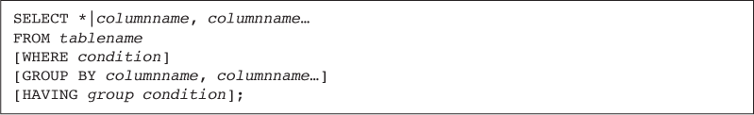
Group Functions
Return one result per group of rows processed
Are also called multiple-row and aggregate functions
All group functions ignore NULL values except COUNT(*)
Use DISTINCT to suppress duplicate values
Oracle 11g: SQL

Slide 6
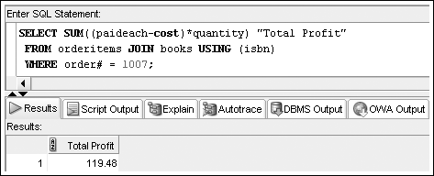
SUM Function
Calculates total amount stored in a numeric column for a group of rows
Oracle 11g: SQL

Slide 7
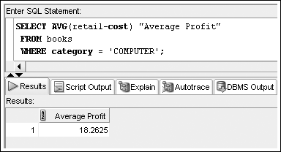
AVG Function
Calculates the average of numeric values in a specified column
Oracle 11g: SQL

Slide 8
COUNT Function
Two purposes
  Count only how many records have non-NULL values in a given column
  Count total records, including those with NULL values anywhere
Oracle 11g: SQL

Slide 9
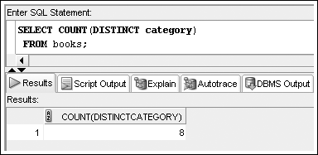
COUNT Function – Non-NULL Values
Include column name in argument to count number of non-NULL occurrences
Oracle 11g: SQL

Slide 10
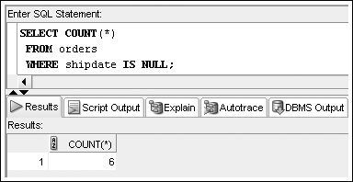
COUNT Function – NULL Values
Include asterisk as argument to count number of rows
Oracle 11g: SQL

Slide 11
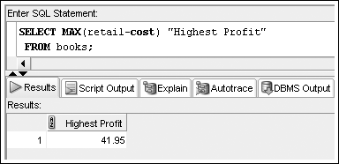
MAX Function
Returns largest value
Oracle 11g: SQL

Slide 12
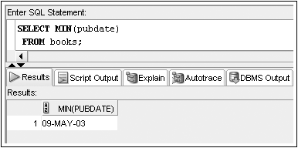
MIN Function
Returns the smallest value
Oracle 11g: SQL

Slide 13
Datatypes
The SUM and AVG functions can only be used on values with numeric datatypes
The COUNT, MIN, and MAX functions can be used on values with numeric, character, and date datatypes
Oracle 11g: SQL

Slide 14
Grouping Data
GROUP BY clause
  Used to group data based on column values
  Must be used for any individual column in the SELECT clause with a group function
  Cannot reference column aliases
Oracle 11g: SQL

Slide 15
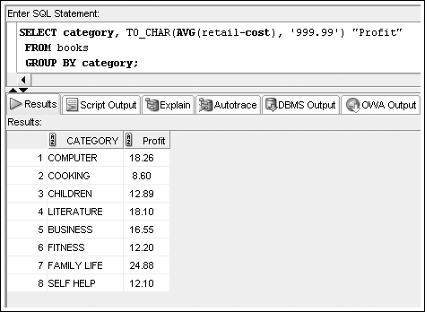
GROUP BY Example
Oracle 11g: SQL

Slide 16
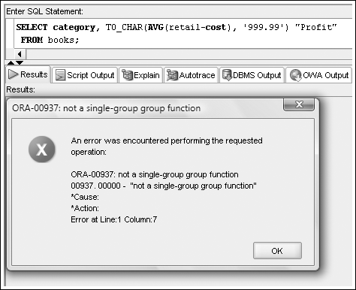
Common Error
A common error is missing a GROUP BY clause for non-aggregated columns in the SELECT clause
Oracle 11g: SQL

Slide 17
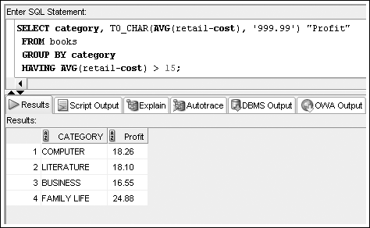
Restricting Aggregated Output
HAVING clause serves as the WHERE clause for grouped data
Oracle 11g: SQL

Slide 18
Restricting Aggregated Output (continued)
When included in the same SELECT statement, the clauses are evaluated in the order of:
  WHERE
  GROUP BY
  HAVING
Oracle 11g: SQL

Slide 19
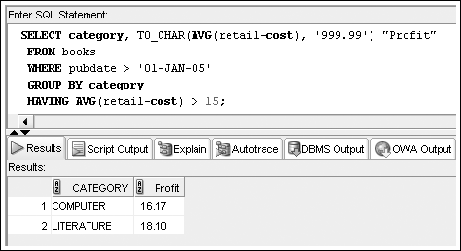
Restricting Aggregated Output (continued)
Oracle 11g: SQL

Slide 20
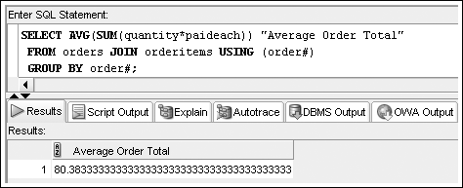
Nesting Functions
Inner function is resolved first
Maximum nesting depth: 2
Oracle 11g: SQL

Slide 21
Statistical Group Functions
Based on normal distribution
Includes:
  STDDEV
  VARIANCE
Oracle 11g: SQL

Slide 22
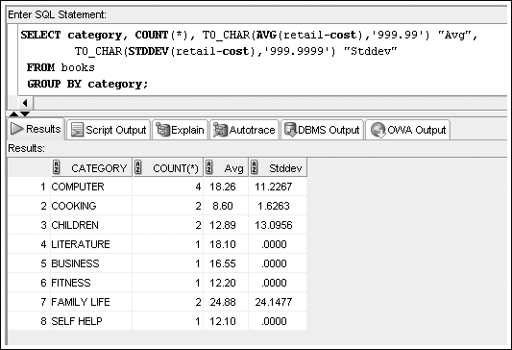
STDDEV Function
Oracle 11g: SQL

Slide 23
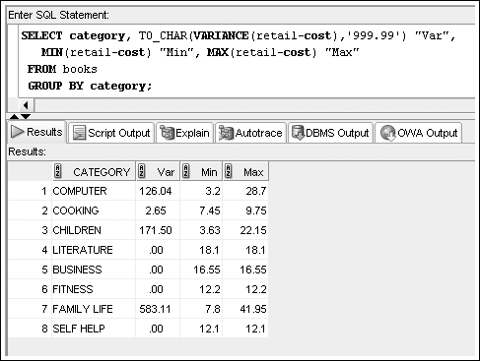
VARIANCE Function
Determines data dispersion within a group
Oracle 11g: SQL

Slide 24
Enhanced Aggregation for Reporting
Oracle provides extensions to the GROUP BY clause, which allow both aggregation across multiple dimensions or the generation of increasing levels of subtotals with a single SELECT statement
A dimension is a term used to describe any category used in analyzing data, such as time, geography, and product line
Each dimension could contain various levels of aggregation; for example, the time dimension may include aggregation by month, quarter, and year
Oracle 11g: SQL

Slide 25
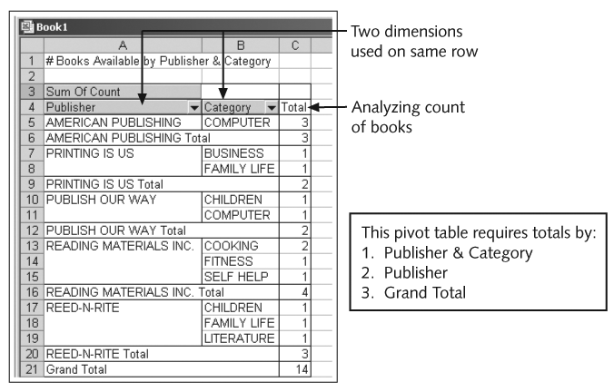
Excel Pivot Table Example
Oracle 11g: SQL

Slide 26
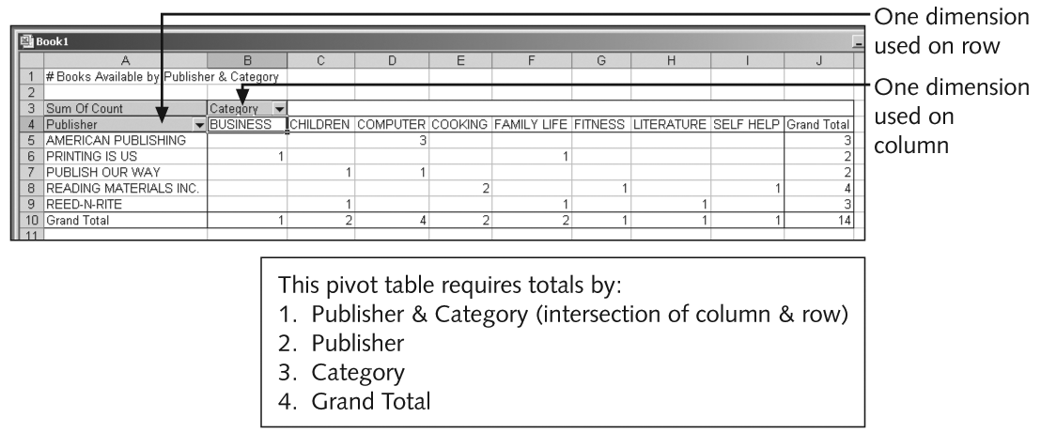
Excel Pivot Table Example (continued)
Oracle 11g: SQL

Slide 27
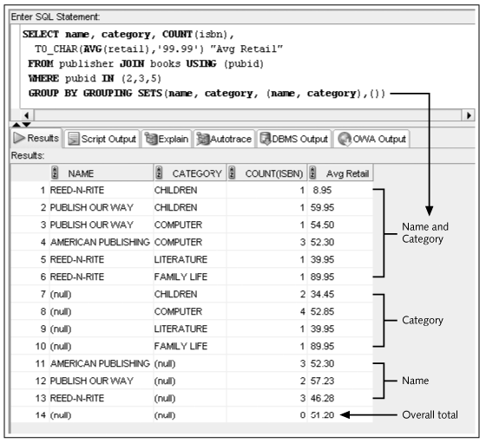
Grouping Sets

Slide 28
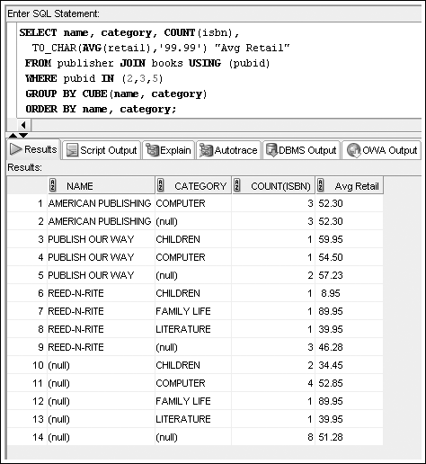
CUBE

Slide 29
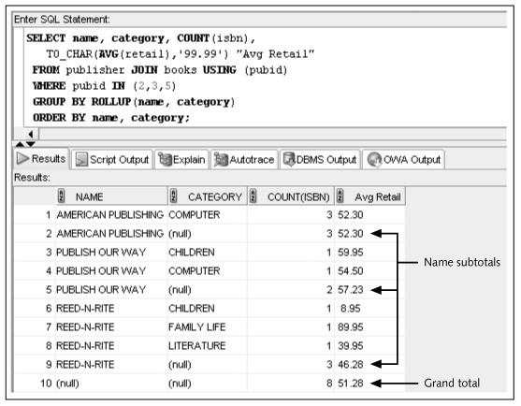
ROLLUP

